Slide 1

Cisco Certified
Network Associate
( CCNA )

Slide 2

学员自我介绍
  Your name
  Your company
  Job responsibilities
  Skills and knowledge
  Brief history
  Objective

Slide 3
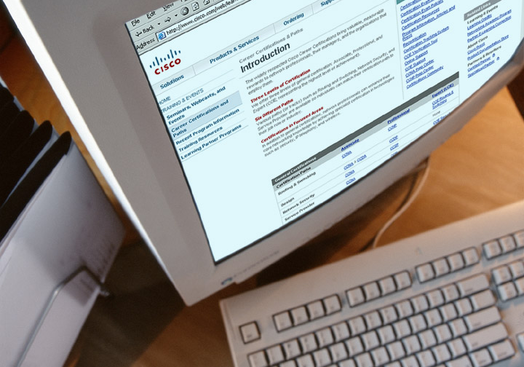
Cisco Career Certifications
Cisco Certifications
www.cisco.com/go/certifications
Notes:
Cisco provides three levels of general certifications for IT professionals with several different tracks to meet individual needs. Cisco also provides focused certifications for designated areas such as cable communications and security. There are many paths to Cisco certification, but only one requirement—passing one or more exams demonstrating knowledge and skill. For details, go to www.cisco.com/go/certifications.
思科提供了三个级别的通用认证专业与几个不同的轨道来满足个人的需要

Slide 4

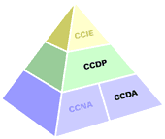
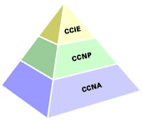
Cisco Career Certifications
CCIE 思科认证网络专家 (Cisco Certified Internetwork Expert)
CCDE思科网络设计专家级别（Cisco Certified Design Expert）
CCNP 思科认证资深网络工程师(Cisco Certified Network Professional)
CCDP 思科认证资深设计工程师(Cisco Certified Design Professional)
CCIP 思科认证资深互联网工程师(Cisco Certified Internetwork Professional)
CCSP 思科认证资深安全工程师(Cisco Certified Security Professional)
CCVP 思科认证资深语音工程师(Cisco Certified Voice Professional)
CCNA 思科认证网络工程师(Cisco Certified Network Associate)
CCDA 思科认证设计工程师(Cisco Certified Design Associate)

Slide 5
CCIE Tracks
Routing & Switching
Core networking cert
74% of all bookings
Labs in all regions, all worldwide locations
Security
Introduced 2002
Fastest growing cert; 13% of bookings
Labs in Beijing, Brussels, RTP, San Jose, Sydney
Voice over IP
Introduced 2003
10% of bookings
Labs in Brussels, San Jose and coming soon in Asia
Storage Networking
Introduced Nov. 2004
Lab opening Q4 2005
Labs in Brussels, RTP, San Jose
Service Provider Networks
Introduced 2002
3% of bookings
Labs in Brussels, Hong Kong, RTP, Sao Paulo, Sydney
…..
http://www.cisco.com/web/CN/learnings/career/paths/ccie/index.html
Notes:
Recent changes have lessened the amount of overlap and focused on more depth in the examinations.
Currently the written labs lag a bit behind the lab exams in this migration.
Tracks are built, changed, and are retired as the industry changes.
路由和交换：核心网络cert 74%的所有预订。实验室在所有地区,全球所有位置
安全：介绍2002，增长最快的cert;13%的预订。实验室在北京,布鲁塞尔,RTP圣何塞,悉尼
IP语音：介绍2003，10%的预订。实验室在布鲁塞尔,圣何塞和即将在亚洲

Slide 6

Process: Steps to CCIE Certification
Routing/Switching
Written
LAB
Security
Written
LAB
Storage
Written
LAB
Service Provider
(Written exam choices)
Cable
Content Netwkg
Metro Ethernet
Dial
LAB
Optical
DSL
WAN Switching
IP Telephony
Voice
Written
LAB
Notes:
Each track uses a combination of computer based and lab based (or other format) exams

Slide 7
CCIE Lab Locations
Beijing
RTP
Brussels
Tokyo

Hong Kong
San Jose
Bangalore
Sydney
Dubai
Sao Paulo
Ten worldwide CCIE lab locations

Slide 8

Find out more at www.cisco.com/go/ccie
© 2003, Cisco Systems, Inc. All rights reserved.

Slide 9































Logo

Slide 10
Company
全面解决方案设备供应商：思科、华为、H3C、锐捷、神州数码、D-Link、北电网络
交换机：思科、H3C、3Com、锐捷、北电网络 、网捷Foundry
路由器： 思科、 Juniper、华为、阿朗、博达、迈普
安全： 思科、 Juniper、天融信、东软、联想网御、飞塔、阿姆瑞特、Nokia、check point、 H3C、安氏、深信服、Array、启明星辰、radware
语音视讯：思科、AVAYA、腾博 TANDBERG、Polycom宝利通、SONY
无线：思科（Aironet、Linksys） 、ARUBA、友讯D-Link、深圳普联 TP-Link
存储：EMC、IBM、HP
宽带接入：华为、 UT斯达康 、阿朗
内容交换/负载均衡/网件加速：F5
软件：趋势科技Trend Micro、赛门铁克Symantec、中软、绿盟
光网络：华为、中兴 3G：诺基亚 、爱立信 、西门子、中兴通讯、大唐移动

Slide 11
Course Roadmap
  学习方法推荐：
  多看书。
  多做实验。
  多交流。
  充分利用网络资源 (推荐几个学习站点)。
  可别忘记Cisco主站：www.cisco.com
  本次CCNA课程安排：

Slide 12


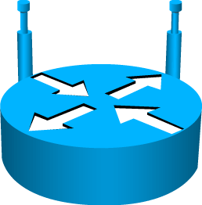


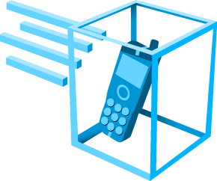




Cisco Icons and Symbols
Router
Wireless
Router
Secure Router
Firewall
Home Office
Workgroup
Switch
Access Point
IP Phone
Mobile
Access
Phone
Small
Business
Wireless
Connectivity
Line: Serial
Line: Ethernet

